Slide 1
Small Scale Stand Alone Hybrid Solar PV and Wind Energy Generation System for EE 452 Lab
Team: Daniel Mendez, Benjamin Holt, Samah Shabbo, Conner Makoben, Mohamed Adam
Advisor/Client: Venkataramana Ajjarapu - Professor of Electrical Engineering
Team Website: http://sddec20-16.sd.ece.iastate.edu, Team Number: sddec20-16
20-16
Notes:
Speaker: Daniel Mendez
To upload an audio file:
1)Record audio
2)Convert to mp3 if needed (i used https://www.zamzar.com/convert/m4a-to-mp3/)
3)Move it to your google drive
4)In the power point slide, click on insert, audio, and then pick your sound file
Don`t forget to share it to me so I could download to my computer and upload to power pointt

Slide 2
Agenda
Project Plan
System Design
Conclusion
Acknowledgements
20-16
Notes:
Speaker: Daniel Mendez

Slide 3
Project Plan
20-16
Notes:
Speaker: Daniel Mendez

Slide 4
Problem Statement
Background
Fossil fuels proven to have environmental impact
U.S Carbon Dioxide emissions = 1,763 million metric tons
Temperature rise of 2.5 to 10 degrees Fahrenheit
Task
Design and develop a standalone hybrid renewable energy generation system
Wind and Solar PV energy
Hardware and software implementation in EE 452 Lab
20-16
Notes:
Speaker: Daniel Mendez

Slide 5
Conceptual Sketch/Diagram
Solar Panel 1
Solar Panel 2
Wind Turbine
Switch
DC Load
AC Load
Controller
Inverter
Battery 1
Battery 2
20-16
Notes:
Speaker: Ben

Slide 6
Functional Requirements
Model solar PV panels and wind simulations
Generation energy from solar cell and wind turbine.
Power conversion from AC to DC and from DC to AC.
Maintain power quality of system for various loads.
Storage of the excess power.
20-16
Notes:
Samah

Slide 7
Non-functional Requirements
Generate clean energy using maximum power point tracking algorithm, inverters, battery bank, and controllers.
Adheres to IEEE standards
Regeneration system adheres to safety standards.
Metering of systems to prevent overvoltage/overcurrent.
Testing and implementation.
Design lab experiments for students
20-16
Notes:
Samah

Slide 8
Constraints and Considerations
Constraints
Geographical location
Use of lab: COVID-19
Non-ideal climate
Energy efficiency
Power losses
Considerations
Safety
Risk analysis
Functionality
Equipment specification
Load management
Cost
Educational benefits
20-16
Notes:
Speaker: Daniel Mendez

Slide 9
Market Survey
Benefits
0.5 tonnes CO2 avoided (2007-2015)
7000 mortalities avoided (2007-2015)
Annual savings of $87.8 billion (2015)
Significance
Contribute to climate change goals
Increase in wind and solar deployment
Education for students
Scalability
20-16
Notes:
Speaker: Daniel Mendez

Slide 10
Potential risks and Mitigation
Results of risk analysis
Electric shock, injury or death
Arcing, explosion, fire causing burns
Fire
Mitigation steps
Ensure all equipment is electrically safe
Comply with all standards
Standard operating procedure
Troubleshoot and reconfigure circuit
Monitor loads
20-16
Notes:
Speaker: Daniel Mendez

Slide 11
Resource and Cost Estimate
All resources applied by ECpE, Iowa State University
Bill of Materials:
Solar panel | $300
Wind turbine | $800
Microcontroller Arduino | $20
Arduino LCD display | $10
Circuit breaker and relay | $65
Digital Multimeter | $150
Toggle switch | $30
Connection wires & Connectors | $40
Panel box | $50
Light bulb bank | $100
Resistor Bank | $100
Total Price
=$1665
20-16
Notes:
Speaker: Samah

Slide 12
Project Milestones and Schedule
Milestone
Milestone
Milestone
Milestone
Milestone
Test Hardware and Solar PV simulations
Design solar PV lab simulations
Test equipment
QA/QC
Cost analysis and Parts list
02
04
06
08
2020
Jan
Feb
Mar
Apr
May
Jun
Jul
Aug
Sep
Oct
Nov
Dec
01
03
05
07
09
Milestone
Milestone
Milestone
Milestone
Milestone
Research Solar PV and Wind Generation
Design Wind generation model
Order equipment
Adjust lab manual
Construct and centralize documentation
20-16
Notes:
Speaker: Daniel Mendez

Slide 13
System Design
20-16
Notes:
Speaker: Daniel Mendez

Slide 14
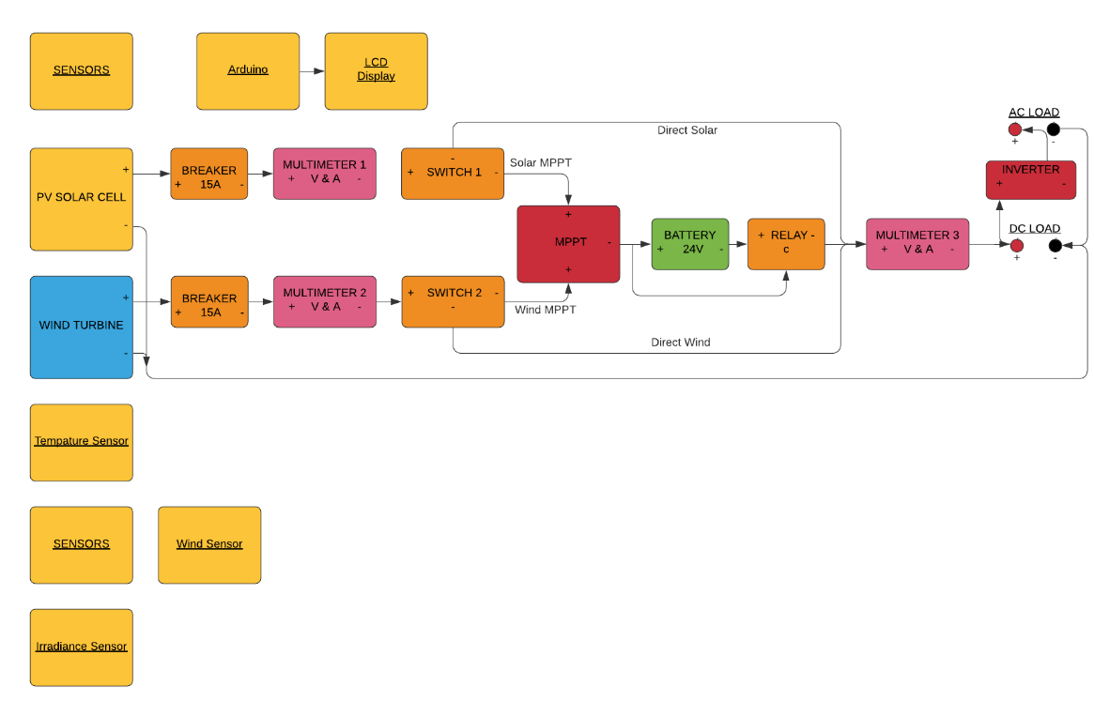
Detailed Design
20-16
Notes:
Speaker: Ben Holt

Slide 15
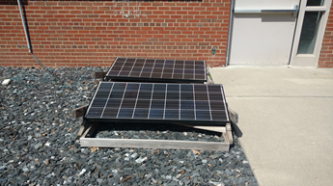
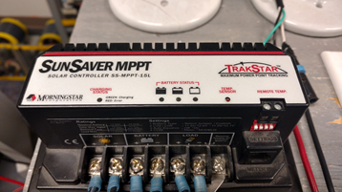
Functional Decomposition
DC Output Functional Decompositions:
Solar arrays generate electrical power
convert solar radiation into direct current electricity
Wind turbine generates electrical power
Convert wind into direct current electricity
Solar and Wind controller
MPPT tracks max power point and charges batteries
Batteries
Store energy supplied by a PV panels
Load
Resistors and used to approximate MPP
20-16
Notes:
Speaker: Ben Holt

Slide 16
Hardware and Software Platforms
Hardware
Wind turbine
Solar Array
Enclosure
Batteries
DC/AC Loads
Converter
inverter
Software
Arduino
Meter wiring
PV and wind model
All software related work used MATLAB/SIMULINK
20-16
Notes:
Speaker: Ben Holt

Slide 17
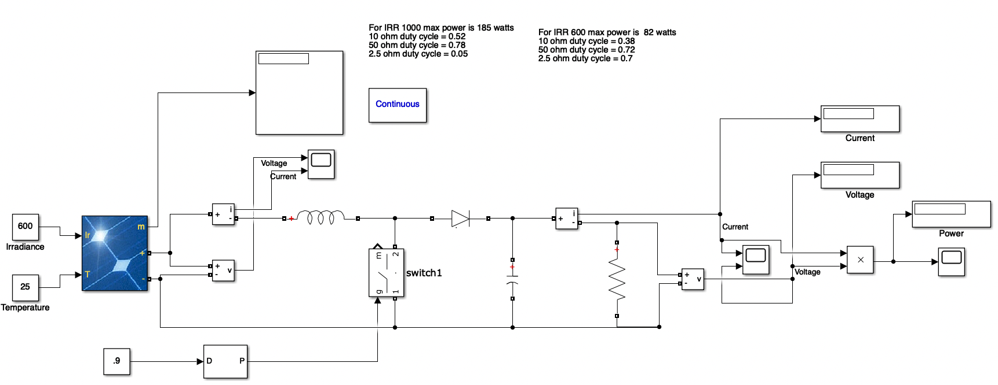
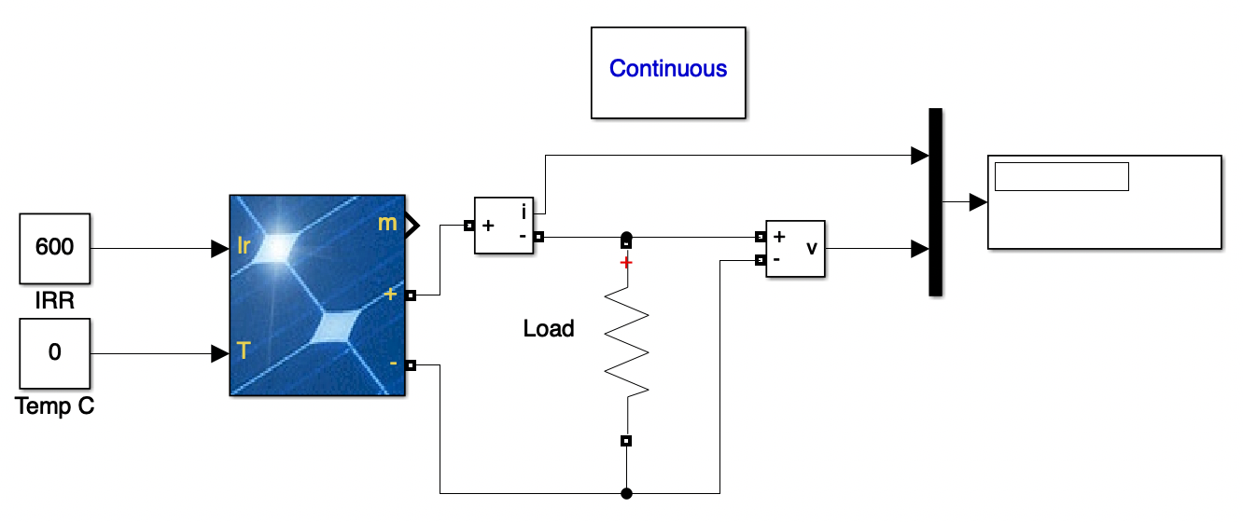
SOFTWARE: SIMULINK PV SYSTEM MODEL
Solar PV behavior MPPT behavior
20-16
Notes:
Speaker: Conner Makoben

Slide 18
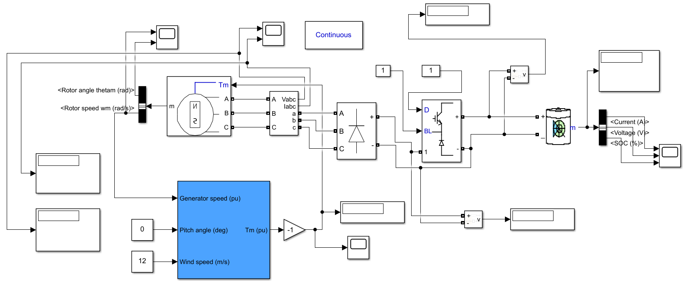
SOFTWARE: SIMULINK WIND TURBINE SYSTEM MODEL
20-16
Notes:
Speaker: Mohamed

Slide 19
Test Plan
Troubleshoot
Measure voltage throughout circuit
Trigger switches and relays
Ensure proper safety measures
Lab Use
Team use and design testing
Students and peers
User with no prior knowledge
20-16
Notes:
Speaker: Ben Holt

Slide 20
Prototype Implementations
Previous Projects
Conceptual models previously developed
Most recent team created a product without wind energy
Implementation timeline
Integration of solar PV
Functional solar PV system prototype by March
Final product by December 2020
Final product will be for lab use
20-16

Slide 21
Conclusion
20-16
Notes:
Speaker: Daniel Mendez

Slide 22
Current Project Status
Research Solar PV and Wind Generation
Test hardware and Solar PV simulations
Develop Solar PV lab manual
Model Wind Generation
Cost Analysis and BOM
Order equipment
Centralize documentation
20-16
Notes:
Speaker: Daniel Mendez

Slide 23
Next Semester
Execute implementation of hybrid system
Centralize documentation
Develop standard operating procedure
Develop hazard analysis
Finalize lab manual
QA/QC checkout
Insure safety for all users
20-16
Notes:
Speaker: Daniel Mendez

Slide 24
Member Responsibility/Contributions
Daniel: Lead Engineer
Ben: Test Engineer
Mohamed: Scribe Engineer
Samah: Research,cost analysis Engineer
Conner: Report Manager
20-16
Notes:
Speaker: Daniel Mendez

Slide 25
Acknowledgements
Professor Ajjarrapu
Pranav Sharma
Priya Vaddepally
ECpE department
All group members
20-16
Notes:
Speaker: Daniel Mendez

Slide 26
Questions?
20-16
Notes:
Speaker: Daniel Mendez

